Slide 1
EventSphere
Sanghamithra Musham-R11910104
Sree Ganesh Seethepalli-R11910904
Meher Sai Saran Bolisetty-R11910676
Pujitha Daram- R118727134
Shounak Kanade-R11912556

Slide 2
Introduction
Event management refers to the process of planning, organizing, co-ordinating, and executing events
In the dynamic and fast-paced world of today, organizing and managing events has become a complex and challenging task.
The Event Management System project aims to provide a centralized platform that facilitates the seamless planning, organization, and execution of diverse events.

Slide 3
outcomes
Implemented a user-friendly event management website. The website will serve as a one-stop destination for individuals and event organizers seeking to sell their tickets .
Also developed a one stop destination for all customers to see all list of events and buy tickets.
Also Developed a admin panel for administrators to mange events .

Slide 4
Technologies USED
Frontend- HTML, CSS, Javascript
Backend- Nodejs, Expressjs
Database- MongoDB

Slide 5
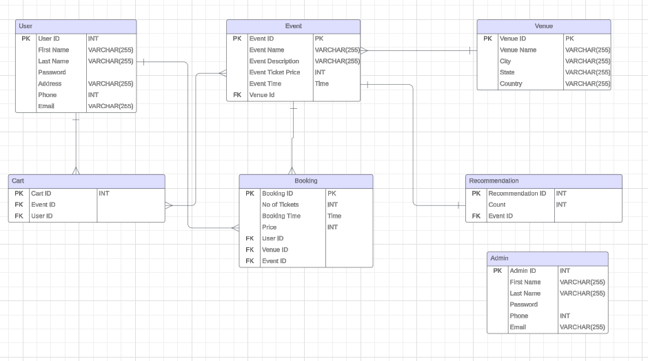
Schema diagram

Slide 6
Prerequisites to run project
Add package.json with following dependencies:
Run npm install
Go to server.js folder and run:
Nodemon server.js

Slide 7
Interface of the website
The website interface contains the following:
Home page
Register
Login In
Search
Cart Page
My Profile (Booking details)
Invoice

Slide 8
Security measures
Password hashing is done while storing the password into the database during registration of the user.

Slide 9
CHALLANGES
Running CSS on Server
Getting the Data
Integrating MongoDB

Slide 10
Future scope
Payment Gateway
Improvement in UI

